Slide 1
WEB ARCHITECTURE. SERVLET API. LIFECYCLE
Volodymyr Paziuk

Slide 2
Web Architecture definition
Web architecture is the conceptual structure of the World Wide Web. The WWW or internet is a constantly changing medium that enables communication between different users and the technical interaction (interoperability) between different systems and subsystems. The basis for this is different components and data formats, which are usually arranged in tiers and build on each other.
Overall, they form the infrastructure of the internet, which is made possible by the three core components of data transmission protocols (TCP/IP, HTTP, HTTPS), representation formats (HTML, CSS, XML), and addressing standards (URI, URL). The term web architecture should be distinguished from the terms website architecture and information architecture.

Slide 3
What is servlet?
Servlet is a Java programming language class that is used to extend the capabilities of servers that host applications accessed by means of a request-response programming model. Although servlets can respond to any type of request, they are commonly used to extend the applications hosted by web servers. For such applications, Java Servlet technology defines HTTP-specific servlet classes.
The javax.servlet and javax.servlet.http packages provide interfaces and classes for writing servlets. All servlets must implement the Servlet interface, which defines life-cycle methods. When implementing a generic service, you can use or extend the GenericServlet class provided with the Java Servlet API. The HttpServlet class provides methods, such as doGet and doPost, for handling HTTP-specific services.

Slide 4
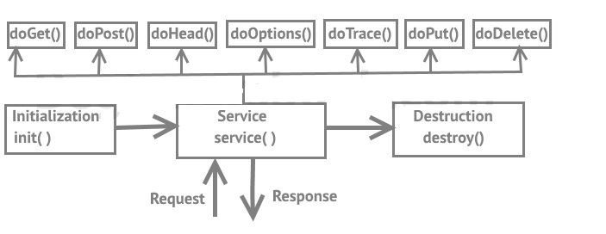
Servlets life cycle
The servlet is initialized by calling the init() method.
The servlet calls service() method to process a client's request.
The servlet is terminated by calling the destroy() method.
Finally, servlet is garbage collected by the garbage collector of the JVM.

Slide 5
The init() method
The init method is called only once. It is called only when the servlet is created, and not called for any user requests afterwards. So, it is used for one-time initializations, just as with the init method of applets.
The servlet is normally created when a user first invokes a URL corresponding to the servlet, but you can also specify that the servlet be loaded when the server is first started.
When a user invokes a servlet, a single instance of each servlet gets created, with each user request resulting in a new thread that is handed off to doGet or doPost as appropriate. The init() method simply creates or loads some data that will be used throughout the life of the servlet.
@Override public void init() throws ServletException { super.init(); }

Slide 6
The service() Method
The service() method is the main method to perform the actual task. The servlet container (i.e. web server) calls the service() method to handle requests coming from the client( browsers) and to write the formatted response back to the client.
Each time the server receives a request for a servlet, the server spawns a new thread and calls service. The service() method checks the HTTP request type (GET, POST, PUT, DELETE, etc.) and calls doGet, doPost, doPut, doDelete, etc. methods as appropriate.
The service () method is called by the container and service method invokes doGet, doPost, doPut, doDelete, etc. methods as appropriate. So you have nothing to do with service() method but you override either doGet() or doPost() depending on what type of request you receive from the client.
@Override public void service(ServletRequest req, ServletResponse res)
throws ServletException, IOException { super.service(req, res); }

Slide 7
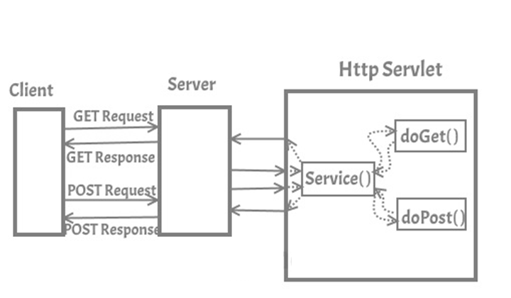

Slide 8
doGet()
A GET request results from a normal request for a URL or from an HTML form that has no METHOD specified and it should be handled by doGet() method.
Called by the server (via the service method) to allow a servlet to handle a GET request.
Overriding this method to support a GET request also automatically supports an HTTP HEAD request. A HEAD request is a GET request that returns no body in the response, only the request header fields.
The GET method should be safe, that is, without any side effects for which users are held responsible. For example, most form queries have no side effects. If a client request is intended to change stored data, the request should use some other HTTP method.
The GET method should also be idempotent, meaning that it can be safely repeated. Sometimes making a method safe also makes it idempotent. For example, repeating queries is both safe and idempotent, but buying a product online or modifying data is neither safe nor idempotent.
Parameters:
req - an HttpServletRequest object that contains the request the client has made of the servlet
resp - an HttpServletResponse object that contains the response the servlet sends to the client

Slide 9
doPost()
A POST request results from an HTML form that specifically lists POST as the METHOD and it should be handled by doPost() method.
Called by the server (via the service method) to allow a servlet to handle a POST request. The HTTP POST method allows the client to send data of unlimited length to the Web server a single time and is useful when posting information such as credit card numbers.
When overriding this method, read the request data, write the response headers, get the response's writer or output stream object, and finally, write the response data. It's best to include content type and encoding. When using a PrintWriter object to return the response, set the content type before accessing the PrintWriter object.
This method does not need to be either safe or idempotent. Operations requested through POST can have side effects for which the user can be held accountable, for example, updating stored data or buying items online.
If the HTTP POST request is incorrectly formatted, doPost returns an HTTP "Bad Request" message.
Parameters:
req - an HttpServletRequest object that contains the request the client has made of the servlet
resp - an HttpServletResponse object that contains the response the servlet sends to the client

Slide 10
doPut()
Called by the server (via the service method) to allow a servlet to handle a PUT request. The PUT operation allows a client to place a file on the server and is similar to sending a file by FTP.
doDelete()
Called by the server (via the service method) to allow a servlet to handle a DELETE request. The DELETE operation allows a client to remove a document or Web page from the server.
doOptions()
Called by the server (via the service method) to allow a servlet to handle a OPTIONS request. The OPTIONS request determines which HTTP methods the server supports and returns an appropriate header. For example, if a servlet overrides doGet, this method returns the following header:
Allow: GET, HEAD, TRACE, OPTIONS
doTrace()
Called by the server (via the service method) to allow a servlet to handle a TRACE request. A TRACE returns the headers sent with the TRACE request to the client, so that they can be used in debugging. There's no need to override this method.

Slide 11
destroy()
The destroy() method is called only once at the end of the life cycle of a servlet. This method gives your servlet a chance to close database connections, halt background threads, write cookie lists or hit counts to disk, and perform other such cleanup activities.
After the destroy() method is called, the servlet object is marked for garbage collection.
@Override public void destroy() { super.destroy(); }

Slide 12
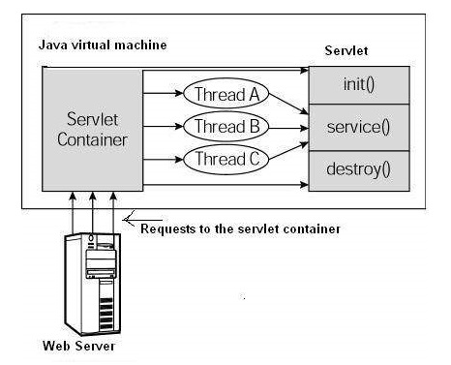
Architecture diagram
First the HTTP requests coming to the server are delegated to the servlet container.
The servlet container loads the servlet before invoking the service() method.
Then the servlet container handles multiple requests by spawning multiple threads, each thread executing the service() method of a single instance of the servlet.

Slide 13
Code Example

